Slide 1
Support Vector Machine
091601
  by Huafu Chen
SLST, UESTC, China

Slide 2
Support Vector Machines (SVMs)
Basic Idea:
Transform the data with a non-linear mapping φ so that it is linearly separable.
Cover’s theorem: non-linearly separable data can be transformed into a new feature space which is linearly separable if 1) mapping is non-linear 2) dimensionality of feature space is high enough
Construct the ‘optimal’ hyperplane (linear weighted sum of outputs of first layer) which maximises the degree of separation (the margin of separation: denoted by ρ) between the 2 classes

Slide 3
MLPs and RBFN stop training when all points are classified correctly. Thus the decision surfaces are not optimised in the sense that the generalization error is not minimized
SVM
ρ
MLP
RBF

Slide 4
x₁
x₂
b= w₀ = bias
Input: m0-D vector
y = Output
y = Σ w_{i} φ(x_{i}) +b
y = w^{T} φ(x)
w_{m1}
φ_{m1} (x)
x_{m0}
First layer: mapping performed from the input space into a feature space of higher dimension where the data is now linearly separable using a set of m₁ non-linear functions (cf RBFNs)

Slide 5
After learning both RBFN and MLP decision surfaces might not be at the optimal position. For example, as shown in the figure, both learning rules will not perform further iterations (learning) since the error criterion is satisfied ( perceptron)
In contrast the SVM algorithm generates the optimal decision boundary (the dotted line) by maximising the distance between the classes ρ which is specified by the distance between the decision boundary and the nearest data points
Points which lie exactly ρ/2 away from the decision boundary are known as Support Vectors
Intuition is that these are the most important points since moving them moves the decision boundary

Slide 6
Moving a support vector moves the decision boundary
Moving the other vectors has no effect
The algorithm to generate the weights proceeds in such a way that only the support vectors determine the weights and thus the boundary

Slide 7
However, we shall see that the output of the SVM can also be interpreted as a weighted sum of the inner (dot) products of the images of the input x and the support vectors x_{i} in the feature space, which is computed by an inner product kernel function K(x,x_{m1})
b = bias
x₁
x₂
y = Output
y = Σ a_{i} d_{i} K(x, x_{i}) + b
Input x: m0-D vector
a_{N}d_{N}
x_{m0}
K_{N} (x) = K(x, x_{N})
= φ^{T}(x). φ( x_{N})
Where: φ^{T}(x) = [φ₁(x), φ₂(x), .. , φ_{m1}(x)]^{T} I.e. image of x in feature space
and d_{i} = +- 1 depending on the class of x_{i}
Notes:
the dimension of feature space is m1,

Slide 8
Why should inner product kernels be involved in pattern recognition?
-- Intuition is that they provide some measure of similarity
-- Inner product in 2D between 2 vectors of unit length returns the cosine of the angle between them.
e.g. x = [1, 0]^{T} , y = [0, 1]^{T}
I.e. if they are parallel inner product is 1
x^{T} x = x.x = 1
If they are perpendicular inner product is 0
x^{T} y = x.y = 0

Slide 9
Differs to MLP (etc) approaches in a fundamental way
In MLPs complexity is controlled by keeping number of hidden nodes small
Here complexity is controlled independently of dimensionality of the input
The curse of dimensionality (which makes finding the optimal weights difficult) is avoided by using the notion of an inner product kernel (see: the kernel trick, later) and optimising the weights in the input space
Notes:
Curse 咒骂， 灾祸

Slide 10
SVMs are a superclass of network containing both MLPs and RBFNs (and both can be generated using the SV algorithm)
Strengths:
Previous slide: i.e. complexity/capacity is independent of dimensionality of the data thus avoiding curse of dimensionality
Statistically motivated => Can get bounds on the error, can use the theory of VC dimension and structural risk minimisation (theory which characterises generalisation abilities of learning machines)
Finding the weights is a quadratic programming(QP) problem guaranteed to find a minimum of the error surface. Thus the algorithm is efficient and SVMs generate near optimal classification and are insensitive to over training
Obtain good generalisation performance due to high dimension of feature space
Notes:
二次规划问题

Slide 11
Most important (?): by using a suitable kernel, SVM automatically (w, b) computes all network parameters for that kernel. Eg RBF SVM: automatically selects the number and position of hidden nodes (support vector points, weights and bias)
Weaknesses:
Slow training (compared to RBFNs/MLPs) due to computationally intensive solution to QP problem especially for large amounts of training data => need special algorithms
Generates complex solutions (normally > 60% of the data as support point. However, MLP used 2 hidden nodes, SVM used 285. – the example of the bayes classification， page 338)
Difficult to incorporate prior knowledge.

Slide 12
The SVM was proposed by Vapnik and colleagues in the 70’s but has only recently become popular early 90’s). It (and other kernel techniques) is currently a very active (and trendy) topic of research
See for example:
http://www.kernel-machines.org
or (book):
AN INTRODUCTION TO SUPPORT VECTOR
MACHINES (and other kernel-based learning methods). N. Cristianini and J. Shawe-Taylor, Cambridge University Press. 2000. ISBN: 0 521 78019 5
for recent developments
Notes:
RBF 中 也有 核函数网络

Slide 13
First consider a linearly separable problem where the decision boundary is given by
g(x) = w^{T}x+ b = 0
And a set of training data X={(x_{i},d_{i}): i=1, .., N} where d_{i} = +1 if x_{i} is in class 1 and –1 if it’s in class 2.
Let the optimal weight-bias combination be w₀ and b₀ , let’s seek w₀ and b_{0 ??}
x_{n}
x
x_{p}
w
Now: x = x_{p} + x_{n} = x_{p} + r w₀ / ||w₀|| where: r = ||x_{n}||
Since: g(x_{p}) = 0, g(x) = w₀^{T}(x_{p} + r w₀ / ||w₀||) + b₀
g(x) = r w₀^{T} w₀ / ||w₀|| = r ||w₀||
or: r = g(x)/ ||w₀||

Slide 14
Thus, as g(x) gives us the algebraic distance to the hyperplane, we want: g(x_{i}) = w₀^{T}x_{i} + b₀ >= 1 for d_{i} = 1
and g(x_{i}) = w₀^{T}x_{i} + b₀ <= -1 for d_{i} = -1
(remembering that w₀ and b₀ can be rescaled without changing the boundary) with equality (g(x)=1) for the support vectors x_{s.} Thus, considering points on the boundary( g(x)=1) and that:
r = g(x)/ ||w₀||
we have:
r = 1/ ||w₀|| for d_{S} = 1 and r = -1/ ||w₀|| for d_{S} = -1
and so the margin of separation is:
ρ = 2 / ||w₀||
Thus, the solution w₀ maximises the margin of separation
Maximising this margin is equivalent to minimising ||w||
Notes:
最小 模解 就是 这个最大 “分离” 解
对 Support vectors （g(x)=1) 完全拟合，同时满足 约束条件（其它点在之外 |g(x)|>1）， 这个时候的解 就是 MN 解--- 相当与认为有些点 是没有误差的，而有的点有误差 （不同的加权！！）， 这里需要先知道 那些是精确点， 而QP不需要，它采用 lagrange技术

Slide 15
We now need a computationally efficient algorithm to find w₀ and b₀ using the training data (x_{i}, d_{i}). That is we want to minimise:
F(w) = 1/2 w^{T}w
subject to: d_{i}(w^{T}x_{i} + b) >= 1 for i= 1, .. N
which is known as the primal problem. Note that the cost function F is convex in w (=> a unique solution) and that the constraints are linear in w.
Thus we can solve for w using the technique of Lagrange multipliers.
Notes:
primal problem 原 问题
Lagrange multipliers (non-maths: technique for solving constrained optimisation problems). For a geometrical interpretation of Lagrange multipliers see Bishop, 95, Appendix C.

Slide 16
First we construct the Lagrangian function:
L(w , a) = 1/2 w^{T}w - Σ_{i} a_{i} [d_{i}(w^{T}x_{i} + b) - 1] (6.11)
where a_{i} are the Lagrange multipliers.
L must be minimised with respect to w and b
and maximised with respect to a_{i} .
It can be shown that such problems have a saddle-point at the optimal solution:
saddle- for m/b- min, for a_{i} -max.
Notes:
对一组确定的ai，di(wx+b)-1》0 则 L会减小，因此，我们需要 有一组 w,b,使得这个》0要求得到满足（分类要求）， 同时使 1/2wtw尽可能的小， 因此
L must be minimized with respect to w and b
L 对ai 最大化 （ 表面上即 ai 尽可能小，如果都等于0, 就没有意义了），
如果一个 xi使得 di(wx+b)>=0, 则任何 啊ai(>0)都会使 L减小，因此， L 对ai 最大化 的情况：
1） 当 di(wx+b)>0， 取 ai=0
2) di(wx+b)=0,才可 取 ai>0，这样将选出一批点（support vector,正好位于 =0( ()=1)边界上）。

Slide 17
Karush-Kuhn-Tucker conditions of optimization theory(or intuitively, the maximisation / constraint), at the saddle point :
a_{i} [d_{i}(w^{T}x_{i} + b) - 1] = 0 (6.14)
( at this moment L(w,a) is max for a_{i} )
→ Only when the data point is a support vector
( []=0), multiplier a_{i} can assume nonzero values; otherwise a_{i} = 0.
Notes:
zero is the maximization, other case, it is smaller than zero because there is a “-” before this term
Since a_{0,i} = 0 if x_{i} is not a support vector, ONLY the support vectors determine the optimal hyperplane which was our intuition ( 6.12)

Slide 18
2. We set the partial derivatives of L with respect to b and w to zero to obtain the conditions of optimality:
w = Σ_{i} a_{i} d_{i} xi (6.12)
and
Σ_{i} a_{i} d_{i} = 0 (6.13)
Notes:
From (6.13) we obtain ai, and then get w from (6.12)

Slide 19
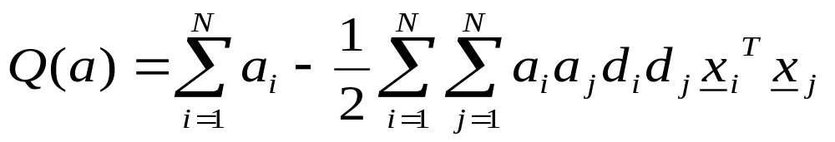
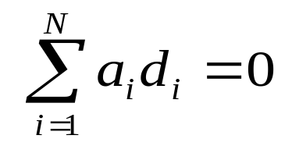
We can reform the primal problem using the above optimality conditions to get the equivalent dual problem:
(page 324: (6.15) → (6.16) )
Finally, given the training data sample {(x_{i},d_{i}), i=1, …,N}, find the Lagrangian multipliers a_{i} which maximise: ( dual problem)
subject to the constraints:
and a_{i} >=0 for i=1,..,N (6.11)
1) Here Q(a) to be maximized depends only on the input patterns in the form of a set of dot products of the input vector. So we may get the multipliers at first.
Notes:
通过解对偶问题来解原问题
Given such a constrained convex problem, we can reform the primal problem using the optimality conditions to get the equivalent dual problem:

Slide 20
2) Once the optimal Lagrangian multipliers a_{0, i} have been found we can use them to find the optimal w:
w₀ = Σ a_{0,i} d_{i} x_{i} （6.12)
and the optimal bias from the fact that for a positive support vector:
w^{T}x_{i} + b₀ = 1
=> b₀ = 1 - w₀^{T}x_{i}
[However, from a numerical perspective it is better to take the mean value of b₀ resulting from all such data points (support vector) in the sample].
Since a_{0,i} = 0 if x_{i} is not a support vector, ONLY the support vectors determine the optimal hyperplane which was our intuition ( 6.12)

Slide 21
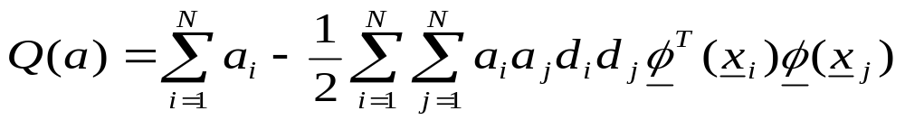
For a non-linearly separable problem we have to first map data onto feature space so that they are linear separable
x_{i} φ(x_{i})
with the procedure for determining w the same except that x_{i} is replaced by φ(x_{i}) that is:
Given the training data sample {(x_{i},d_{i}), i=1, …,N}, find the optimum values of the weight vector w and bias b
w = Σ a_{0,i} d_{i} φ(x_{i})
where a_{0,i} are the optimal Lagrange multipliers determined by maximising the following objective function
subject to the constraints
Σ a_{i} d_{i} =0 ; a_{i} >0
Notes:
这里关于 ai/aj 最多是 二次，因此，通过求导 就可以得到结果
Dz
Here Map 其实就是 RBF中的投影到高dimension 的过程，因此，这里的map 一般是一个多维的投影，即把输入空间的每一点（a vector) 都投影到高维的空间中去，成为那里的一点，

Slide 22
Example XOR problem revisited:
Let the nonlinear mapping be ( two dimensional(x1,x2) ):
φ(x) = (1,x₁², 2^{1/2} x₁x₂, x₂², 2^{1/2} x₁ , 2^{1/2} x₂)^{T}
And: φ(x_{i})=(1,x_{i1}², 2^{1/2} x_{i1}x_{i2}, x_{i2}², 2^{1/2} x_{i1} , 2^{1/2} x_{i2})^{T}
Therefore the feature space is in 6D with input data in 2D
x₁ = (-1,-1), d₁= - 1
x₂ = (-1,1), d₂= 1
x₃ = (1,-1), d₃= 1
x₄ = (-1,-1), d₄= -1

Slide 23
Q(a)= Σ a_{i} – ½ Σ Σ a_{i} a_{j} d_{i} d_{j} φ(x_{i}) ^{T}φ(x_{j})
= -1/2 (1+1+2+1+2+2) a₁ a₁
+1/2 (1+1-2+1+2-2)a₁ a₂ +…
+a₁ +a₂ +a₃ +a₄
=a₁ +a₂ +a₃ +a₄ – ½(9 a₁ a₁ - 2a₁ a₂ -2 a₁ a₃ +2a₁ a₄
+9a₂ a₂ + 2a₂ a₃ -2a₂ a₄ +9a₃ a₃ -2a₃ a₄ +9 a₄ a₄ )
To minimize Q, we only need to calculate Partial Q /partial a_{i} = 0 (due to optimality conditions) which gives
1 = 9 a₁ - a₂ - a₃ + a₄
1 = -a₁ + 9 a₂ + a₃ - a₄
1 = -a₁ + a₂ + 9 a₃ - a₄
1 = a₁ - a₂ - a₃ + 9 a₄

Slide 24
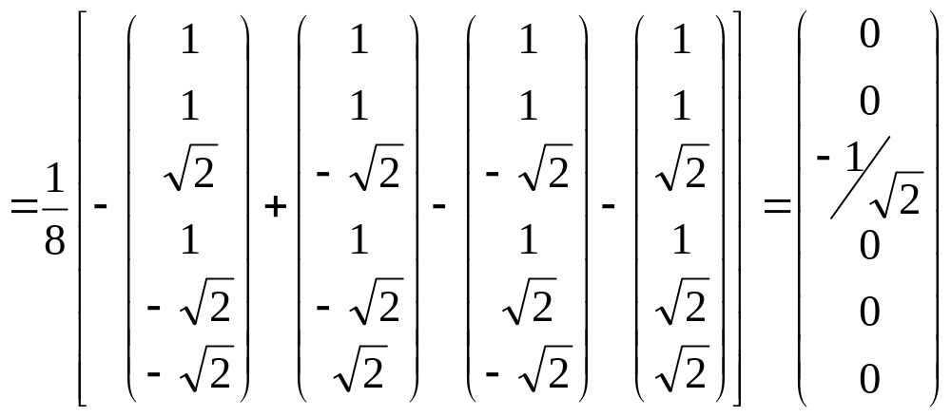
The solution of which gives the optimal values:
a_{0,1} =a_{0,2} =a_{0,3} =a_{0,4} =1/8
w₀ = Σ a_{0,i} d_{i} φ(x_{i})
= 1/8[φ(x₁)- φ(x₂)- φ(x₃)+ φ(x₄)]
Where the first element of w₀ gives the bias b

Slide 25
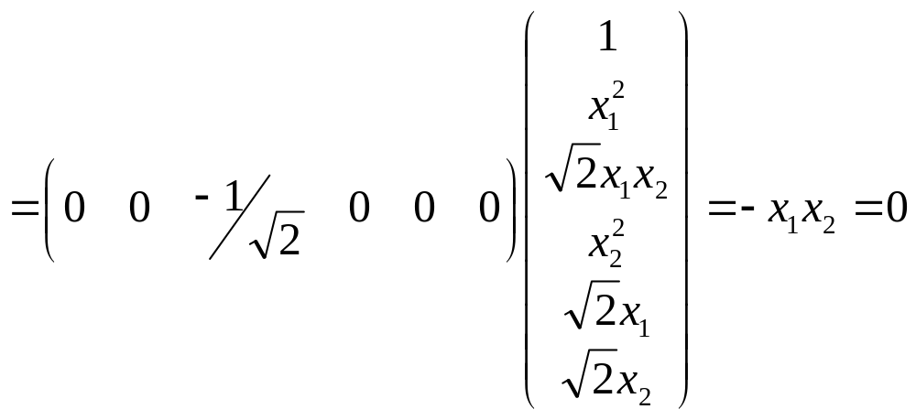
From earlier we have that the optimal hyperplane is defined by:
w₀^{T} φ(x) = 0
That is:
w₀^{T} φ(x)
which is the optimal decision boundary for the XOR problem. Furthermore we note that the solution is unique since the optimal decision boundary is unique
Notes:
我们用 MLP， RBF, SVM 都做过XOR，但SVM是最好的？！

Slide 26
SVM building procedure:
Pick a nonlinear mapping φ
Solve for the optimal weight vector
However: how do we pick the function φ?
In practical applications, if it is not totally impossible to find φ, it is very hard
In the previous example, the function φ is quite complex: How would we find it?
Answer: the Kernel Trick

Slide 27
Notice that in the dual problem the image of input vectors only involved as an inner product meaning that the optimisation can be performed in the (lower dimensional) input space and that the inner product can be replaced by an inner-product kernel
Q(a) = Σ a_{i} – ½ Σ Σ a_{i} a_{j} d_{i} d_{j} φ(x_{i}) ^{T} φ(x_{j})
= Σ a_{i} – ½ Σ Σ a_{i} a_{j} d_{i} d_{j} Κ(x_{i}, x_{j})
How do we relate the output of the SVM to the kernel K?
Look at the equation of the boundary /hyperplane in the feature space and use the optimality conditions derived from the Lagrangian formulations
Notes:
内积有降低dimension的作用

Slide 28
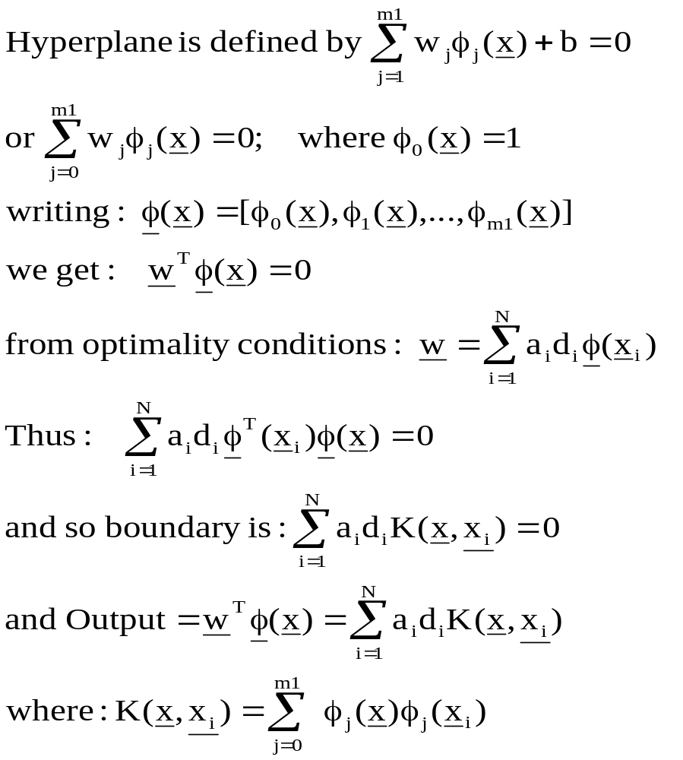
Notes:
The output is the hyperplane of the classification

Slide 29
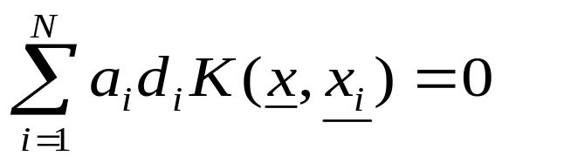
In the XOR problem, we chose to use the kernel function:
K(x, x_{i}) = (x ^{T} x_{i}+1)²
= 1+ x₁² x_{i1}² + 2 x₁x₂ x_{i1}x_{i2} + x₂² x_{i2}² + 2x₁x_{i1} ,+ 2x₂x_{i2}
Which implied the form of our nonlinear functions:
φ(x) = (1,x₁², 2^{1/2} x₁x₂, x₂², 2^{1/2} x₁ , 2^{1/2} x₂)^{T}
And: φ(x_{i})=(1,x_{i1}², 2^{1/2} x_{i1}x_{i2}, x_{i2}², 2^{1/2} x_{i1} , 2^{1/2} x_{i2})^{T}
However, we did not need to calculate φ at all and could simply have used the kernel to calculate:
Q(a) = Σ a_{i} – ½ Σ Σ a_{i} a_{j} d_{i} d_{j} Κ(x_{i}, x_{j})
Maximised and solved for a_{i} from this dual problem, then the derived hyperplane is:

Slide 30
We therefore only need a suitable choice of kernel function:
Mercer’s Theorem:
Let K(x,y) be a continuous symmetric kernel that defined in the
closed interval [a,b]. The kernel K can be expanded in the form
Κ (x,y) = φ(x) ^{T} φ(y)
provided it is positive definite. Some of the usual choices for K are:
Polynomial SVM (x ^{T} x_{i}+1)^{p} p specified by user
RBF SVM exp(-1/(2σ²) || x – x_{i}||²) σ specified by user
MLP SVM tanh(s₀ x ^{T} x_{i} + s₁) Mercer’s theorem not satisfied for all s₀ and s₁

Slide 31
How to recover φ from a given K ???? Not essential that we do…
Further development
1. In practical applications, it is found that the support vector
machine can outperform other learning machines
2. How to choose the kernel?
3. How much better is the SVM compared with traditional machine?
Feng J., and Williams P. M. (2001) The generalization error of the symmetric and scaled support vector machine IEEE T. Neural Networks Vol. 12, No. 5. 1255-1260

Slide 32
With Haykin software directory as the working path of Matlab /page 336 6.6
Three steps:
Training samples (x_{i},d_{j} )
1. Choose the kernel function K
2. Determine a_{i} by solving the following equation
Q(a) = Σ a_{i} – ½ Σ Σ a_{i} a_{j} d_{i} d_{j} Κ(x_{i}, x_{j})
3. Resulted hyper-plane

Slide 33
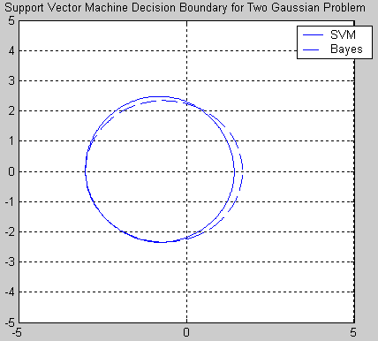
With Haykin software directory as the working path of Matlab /page 336 6.6
Bayes (optimal)
81.15%
Table 6.3/ page 338
500 points training
32000 points test
five times: average
81.40%
Almost the optimal
Notes:
% 1. make data set with 200 rows and 5columns
P = mk_data(200);
% 2. run the SVM routine,return weights, support vectors and bias
[pesos,vect,b] = svm_rbf(P, 8, 1000, .01, .1);
% 3. make a test set with 200 rows and 5columns
T = mk_data(200);
% 4. test data ,return percents of correct classifications and uncorrect classifications
[c u] = svm_test(T, pesos, vect, b, 8);
% 5. plots the decision boundary for the two class Gaussian problem
svm_dec_bnd(pesos, vect, b, 8)

